Slide 1
General and Generalized Linear Models: Overview and Applications
Michael Otterstatter
BCCDC Biostats Session
May 10, 2019

Slide 2
Session overview
In this session we will discuss
General linear models (GLMs)
What are they?
How do they work?
What are some applications?
Generalized linear models (GLIMs)
What are they?
How do they work?
What are some applications?

Slide 3

Background
When we make observations, we are usually seeing a combination of patterns (‘signal’) and haphazard variation (‘noise’)

Slide 4
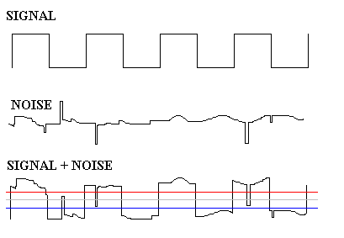
Background
That is, we think of data as being
observations = signal + noise
Underlying pattern
of interest
Other sources
of variation
What we actually
observe

Slide 5
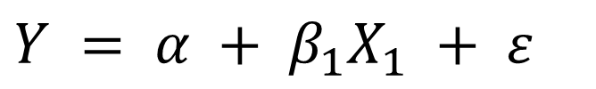
Background
Statistical models try to understand the relationship of signal and noise that generates data
observations = signal + noise
If we understand this relationship, we can
succinctly summarize patterns
explain observed patterns
predict future patterns
$$Y = α + β_{1}X_{1} + ε$$

Slide 6
Background
Statistical models often use an equation of a straight line to represent observations as pattern + noise
“The line of best fit”
Y
“The equation of a straight line”
X₁

Slide 7

A bit of history
Classical linear models, like linear regression, were first used to study position of astronomical bodies by Gauss in the early 1800s
Variability in such measurements was largely due to measurement error, for which the Normal or Gaussian distribution was used
Even at that time, Gauss showed that linear models are sensitive to particular aspects of the data: equal variance, independence of observations, and normally distributed errors

Slide 8
Linear model basics
What is a GLM?
The general linear model (GLM) represents the pattern with a set of parameters (e.g., α, β) plus unexplained (‘residual’ or ‘error’) variation (ε)
predictor
variable
intercept parameter
ε
Y
response
variable
slope
parameter
error
‘residual’
α
X₁

Slide 9
Linear model assumptions
What is a GLM?
Relationship between response and predictor(s) is linear
Errors are normally distributed and have constant variance
Errors are independent of one another

Slide 10

What is linear in the model?
What is a GLM?
A true linear model is linear in its parameters. Hence, a linear regression is based on an equation that is linear in its parameters but may not be linear in its variables
Polynomial regression is
a linear model

Slide 11



What is linear in the model?
What is a GLM?
Which of these are linear models?

Slide 12



What is linear in the model?
What is a GLM?
Keep in mind, lots of non-linear models can be made linear in their parameters by transformations:

Slide 13
A cautionary tale
What is a GLM?
“Anscombe's quartet”
Anscombe, F. J. 1973. "Graphs in Statistical Analysis". American Statistician. 27: 17–21.

Slide 14
A cautionary tale
What is a GLM?
In each of the four datasets,
Mean of x: 9.00
Variance of x: 11.00
Mean of y: 7.50
Variance of y: 4.125
Correlation between x and y: 0.816

Slide 15
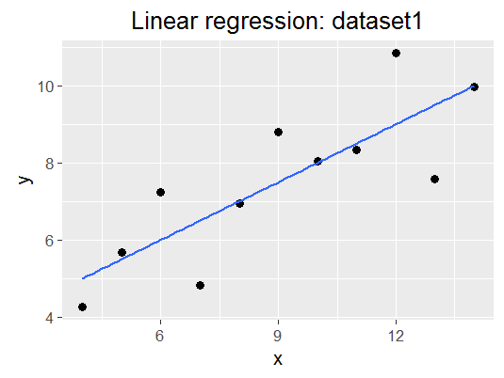
A cautionary tale
What is a GLM?

Slide 16
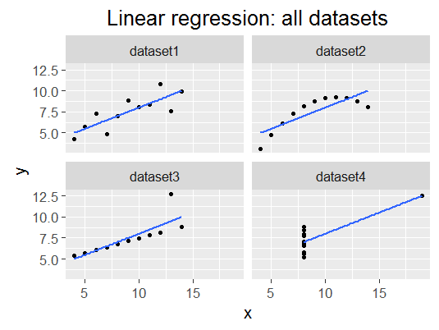
A cautionary tale
What is a GLM?
Regression line is
y = 3.00 + 0.500x
for all four datasets!

Slide 17
A cautionary tale
What is a GLM?
Lessons from Anscombe's quartet
Specifying an appropriate regression model requires careful examination of the data
Linear regression is limited for capturing patterns and can imply relations that do not exist
Healthy skepticism toward linear regression results is warranted given how easily things can go wrong (also see Chatterjee & Firat 2007. Am Stat 61:248)

Slide 18
Applications of linear models
General linear models include
Linear regression (most common form)
ANOVA (special case of linear regression)
ANCOVA
MANOVA (multivariate form of ANOVA)
MANCOVA (multivariate form of ANCOVA)
t-test
F-test

Slide 19
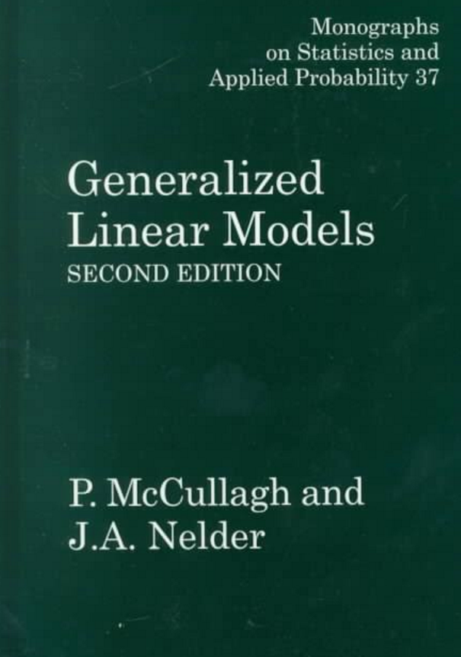
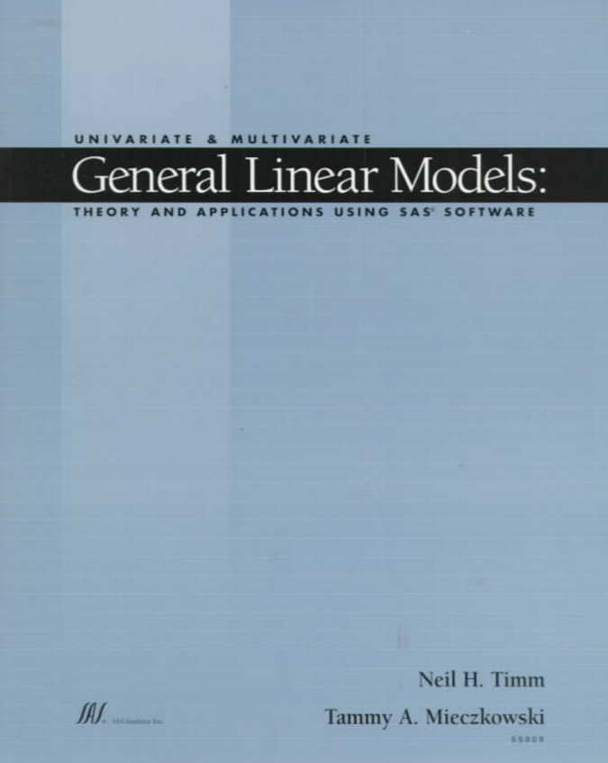
What about generalized linear models?
What’s the difference between a general linear model and a generalized linear model?
?

Slide 20
General vs generalized
https://en.wikipedia.org/wiki/Comparison_of_general_and_generalized_linear_models

Slide 21
Generalized linear models (GLIMs)
What is a GLIM?
GLIMs expand on general linear models in two important ways:
Response variable Y assumed to have a distribution from the exponential family
Normal (ordinary linear regression, ANOVA, etc.):
Gamma
Binomial (logistic regression)
Negative binomial
Multinomial
Poisson
and others (inverse Gaussian, negative binomial, zero-inflated Poisson and negative binomial)

Slide 22
Generalized linear models (GLIMs)
What is a GLIM?
GLIMs expand on general linear models in two important ways:
The expected value of the response variable (μ_{i}) is related to a linear equation of predictors through a link function (g)
Note that in ordinary linear models (Normal distribution) the link function is simply the ‘identity’ of μ_{i}:

Slide 23
Generalized linear models (GLIMs)
What is a GLIM?
In Binomial (logistic) regression, a logit link is typically used
In Poisson regression, a log link* is typically used
* natural (base e) logarithm

Slide 24
Assumptions of GLIMs
What is a GLIM?
Relationship between transformed response g(μ_{i}) and predictor(s) is linear
Residuals should be evenly distributed and have constant variance (but not assumed to be normally distributed)
Residuals are independent of one another
g(u)

Slide 25
An aside
What is a GLIM?
Unlike general linear models, GLIM residuals are not always very helpful for model diagnostics
In binomial models, residuals can have only two possible values for a given model fit
In small datasets, binomial and Poisson residuals tend to show curved lines of points

Slide 26
General vs generalized
What is a GLIM?
For general linear models (e.g., ordinary linear regression), parameter estimates are calculated using least squares
output includes family measures such as F-tests, sums-of-squares, R-squared, etc.
However, for GLIMs, estimation is typically done using maximum likelihood, which finds solutions via numerical optimization
output includes less family measures such as deviance, AIC, dispersion, likelihood ratio chi-square, etc.)

Slide 27
Poisson regression as an example
How do GLIMs work?
Poisson regression assumes the underlying data generating process produces rare, random events (discrete, non-negative counts)
where ‘rare’ is meant relative to the large number of events that could possibly have occurred (but didn’t) in the sampling unit or interval
Examples:
car crashes on a particular stretch of road
phone calls to a switchboard
Particle emissions due to radioactive decay
μ = 3

Slide 28
An aside
How do GLIMs work?
Poisson distributions with small mean values (μ < 10) are distinctly skewed, but with larger means (μ >10), they increasingly approximate the Normal distribution
Yet, Poisson regression is distinctly different from ordinary linear regression (non-negative integers only, multiplicative effects, etc.)

Slide 29
Poisson regression as an example
How do GLIMs work?
If we write out the formal definition of a Poisson model, it helps to clarify what assumptions are being made:
the observed count y in sampling unit i is assumed to come from a Poisson distribution with mean u specific to that unit i (see Appendix slides for further explanation)
the natural log of u_{i} is assumed to be a linear function of the regression variables x₁, x₂…

Slide 30
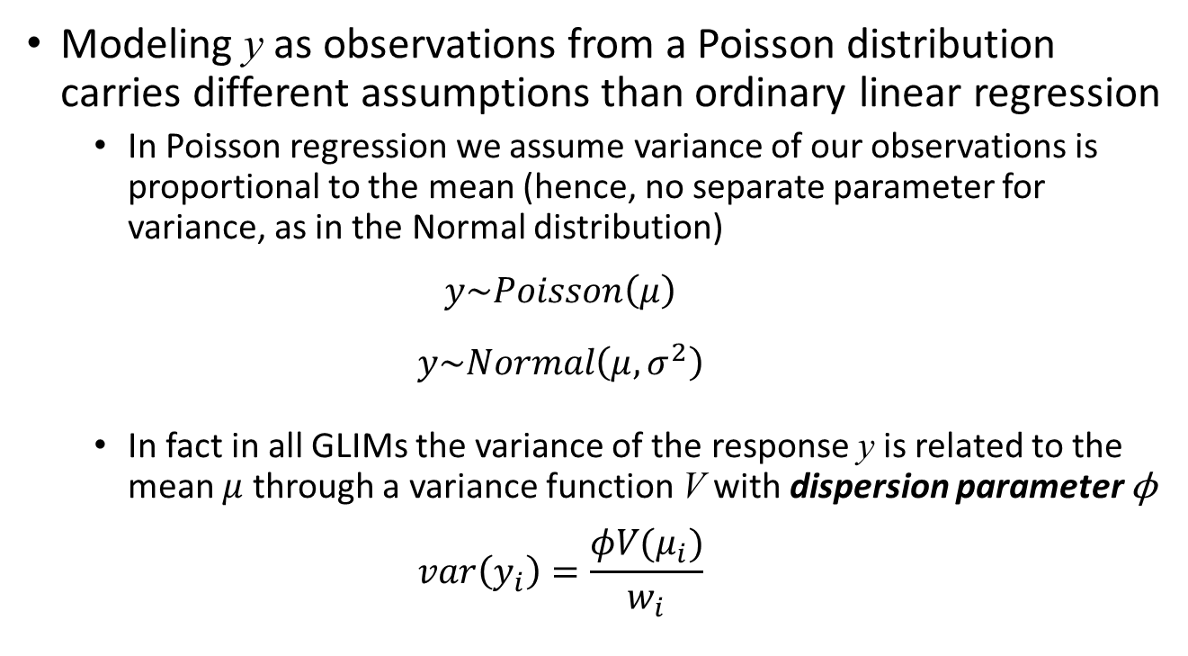
Poisson regression as an example
How do GLIMs work?
Modeling y as observations from a Poisson distribution carries different assumptions than ordinary linear regression
In Poisson regression we assume variance of our observations is proportional to the mean (hence, no separate parameter for variance, as in the Normal distribution)
$$y\sim Poisson\left(μ\right)$$
$$y\sim Normal\left(μ, σ^{2}\right)$$
In fact in all GLIMs the variance of the response y is related to the mean $μ$ through a variance function V with dispersion parameter ϕ
$$var\left(y_{i}\right)=\frac{φV(μ_{i})}{w_{i}}$$

Slide 31
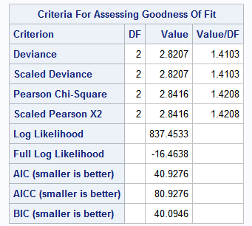
Poisson regression as an example
How do GLIMs work?
Whenever running a Poisson (or binomial) regression, we need to check this assumption of variance proportional to the mean, i.e., that the dispersion parameterϕ = 1
Measures of deviance divided by the model degrees of freedom should be roughly equal to 1.0
If not, variance is likely greater than (overdispersion) or less than (underdispersion) proportional to the mean

Slide 32
Poisson regression as an example
How do GLIMs work?
Poisson regression usually involves some notion of time (e.g., intervals between events, ‘inter-arrival times’) or ‘exposure’ and therefore naturally suited to modeling rates
Where log(n) is the natural log of the exposure variable, aka the ‘offset’, e.g., time, population size, or any other denominator for the rate
Equivalently:

Slide 33

Poisson regression as an example
How do GLIMs work?
Running Poisson models is just as easy as ordinary linear regression!
In SAS:
In R:

Slide 34
Applications of GLIMs
Applications of GLIMs
Generalized linear models include
Linear regression, ANOVA (continuous outcome)
Binomial regression (binary outcome, probabilities)
Poisson regression (counts, rates)
Multinomial regression (multiple categorical outcome)
Gamma regression (flexible; could be used for survival data)

Slide 35
Summary
Generalized linear models (GLIMs) are fundamentally similar to ordinary linear models, but with enhancements that allow analysis of many types of data (counts, binary outcomes, categorical data)
GLIMs make certain assumptions, similar to general linear models, that must be assessed to ensure model validity
Certain technical aspects of GLIMs sound confusing (deviance, dispersion, maximum likelihood) but generally have easily understood meanings – ask your favourite statistician ☺

Slide 36
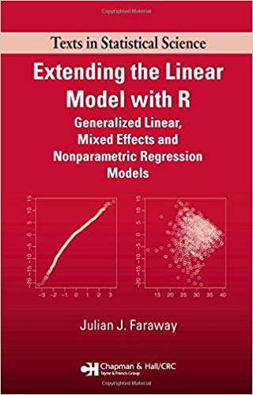
Useful references
McCullagh P, Nelder JA. 1989. Generalized Linear Models. Chapman & Hall.
Faraway, J. J. (2016). Extending the linear model with R: Generalized linear, mixed effects and nonparametric regression models. Chapman and Hall/CRC.

Slide 37
Appendix: clarifying points
Imagine a data set with i observed counts that we wish to use in a regression, and each observed count y_{i} has an associated covariate value x_{i}. If we fit a Poisson regression, we are assuming that each count y_{i} comes from a Poisson distribution with a mean u_{i}
y_{i} ~ Poisson(u_{i})
This is the same thing as saying the expected value of y_{i} is u_{i} (sometimes written as E(y_{i}) = u_{i}).
The ‘expected value’ refers to the fact that each observation y_{i} is a draw from a Poisson distribution and therefore could have been any of a range of values, but the most likely value (or the mean value, if we took many draws from this Poisson distribution) is u_{i}.
Observations are assumed to be independent of one another, so each y_{i} has an expected value u_{i}. Remember that although a Poisson distribution has only a single parameter u, our regression is not just referring to one Poisson distribution but i Poisson distributions (one for each observation y).
The left-hand side of the regression equation
g(µ_{i})=α+βx_{i}
is therefore not fixed, but has i values. The Poisson regression is attempting to estimate what values of α and β provide the best fit to these expected values, given the covariate values x_{i}.
When the model calculates the best-fit (maximum likelihood) estimates of α and β, we can plug these into the equation above to get the predicted values for each observation.

Slide 38
Appendix: clarifying points
Although it sounds a bit different, the concept of random variation is the same in generalized linear models as in general linear models.
In ordinary linear regression, we model the observed y’s as expected values from the equation y = a + bx, plus some random error (often written as y = a + bx + e). Sometimes for general linear models this is written as the expected value of y, given x
E(y|x) = a + bx
In generalized linear models, we do not refer to random error in the model equation; instead, the random error around our observations is assumed to come from the underlying distribution, for example
y ~ Poisson(u)
So we still have the same concept of random variation, but it is shown differently in generalized linear models and assumed to follow different distributions: in general linear models, random error is assumed to be Normal; in generalized linear models, the random error can come from any of the exponential distributions: Poisson, binomial, gamma, etc.

Slide 39
Appendix: clarifying points
To fit a generalized linear model, imagine a process whereby an algorithm finds the straight line that best fits the observations y_{i}. The parameters of this straight line are our maximum likelihood estimates for α and β. If we plug these estimates into the model equation
g(µ_{i})=α+βx_{i}
we will get the expected value µ_{i} for each observation y_{i}.
Of course, the observations y_{i} are not identical to the expected values µ_{i}; instead, there is some additional variation that we call the residual, or ‘error’.
Just as in general linear models, generalized linear models have specific expectations about this residual variation, e.g., in Poisson and Binomial models, the variation should be proportional to the mean.

